Slide 1

Elevating Library Management with Data-Driven Insights
A comprehensive overview of our interactive dashboard for optimising school library operations.
Aryan Aman

Slide 2

Problem & Objective
School Library Usage Dashboard
The objective is to develop an interactive dashboard for school library administrators and librarians. This tool will centralise the monitoring of book borrowing and return activities, providing actionable insights to enhance efficiency and resource allocation.

Slide 3





Technology Stack & Tools
Our dashboard development leverages a robust set of Python-based tools, chosen for their efficiency in data handling, visualisation, and deployment. This stack ensures a scalable and interactive solution.
Python
Pandas
Matplotlib/Seaborn/Plotly
Core programming language for data processing and backend logic.
Essential for efficient data manipulation and analysis.
Used for creating diverse and insightful data visualisations.
Streamlit
Jupyter Notebook
Facilitates quick development of interactive web-based dashboards.
Utilised for exploratory data analysis and prototyping.

Slide 4
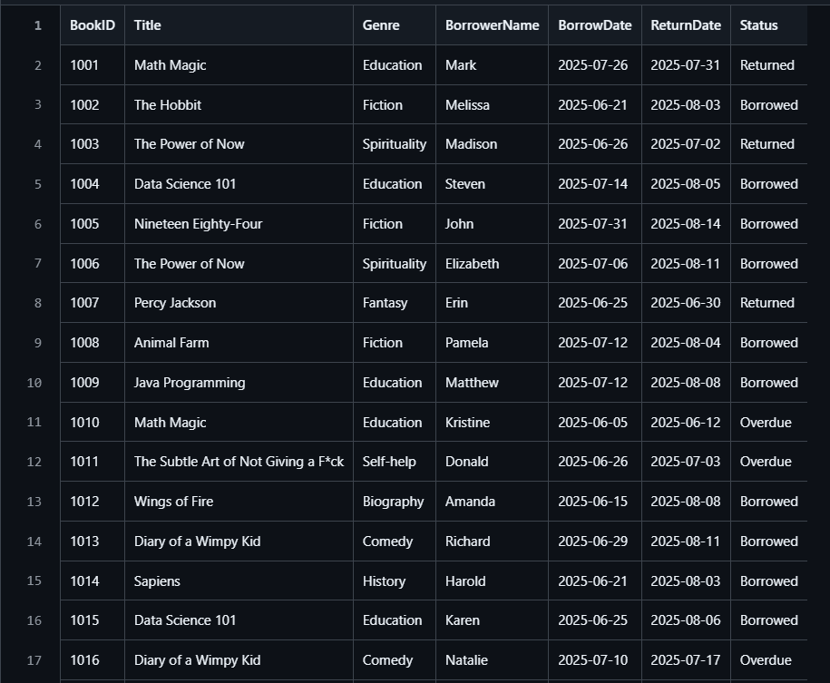
Dataset Overview & Preparation
The dashboard is powered by a comprehensive dataset containing over 1,000 entries, meticulously generated to simulate realistic library activities. This synthetic data ensures robust testing and demonstration of all dashboard functionalities.
Key Data Fields
Book ID : Unique identifier for each book.
Title : Name of the book.
Genre : Categorisation (e.g., Fiction, Science, History).
Borrower Name : Name of the student or staff member.
Borrow Date : Date the book was borrowed.
Return Date : Expected or actual return date.
Status: Current state (Borrowed, Returned, Overdue).
Dataset Size: 1000+ entries, ensuring a broad range of data for analysis.
Data Generation: Utilised the Python Faker library to produce realistic, synthetic data, safeguarding privacy while maintaining data integrity.

Slide 5
Core Dashboard Features
The dashboard is designed for intuitive navigation and comprehensive data exploration, providing librarians with a powerful tool to manage their collections and track usage patterns effectively.
1
Interactive Table View
2
Visualisation of Borrowing Trends
A sortable and searchable table displaying all borrowing activities in detail.
Bar chart for most borrowed books and pie chart for genre distribution.
3
Key Performance Indicators (KPIs)
4
Dynamic Filters & Export
Instant display of total books borrowed and current overdue counts.
Ability to filter by borrow date, status, or search by title, with export to CSV option.

Slide 6
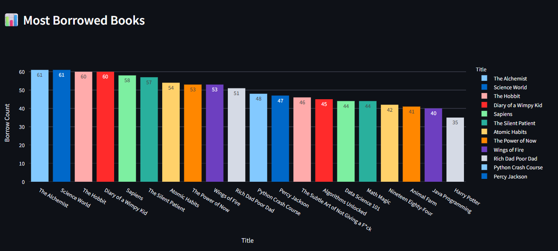
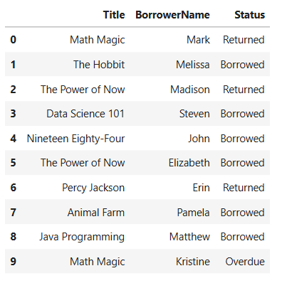
Visualisation Highlights
The dashboard presents data through clear, impactful visualisations, allowing for quick comprehension of library performance and user behaviour.
Most Borrowed Books (Bar Chart)
Interactive Table: View records with book title,
borrower, and status.
Genre Distribution (Pie Chart)
Illustrates the popularity of different genres among borrowers.

Slide 7
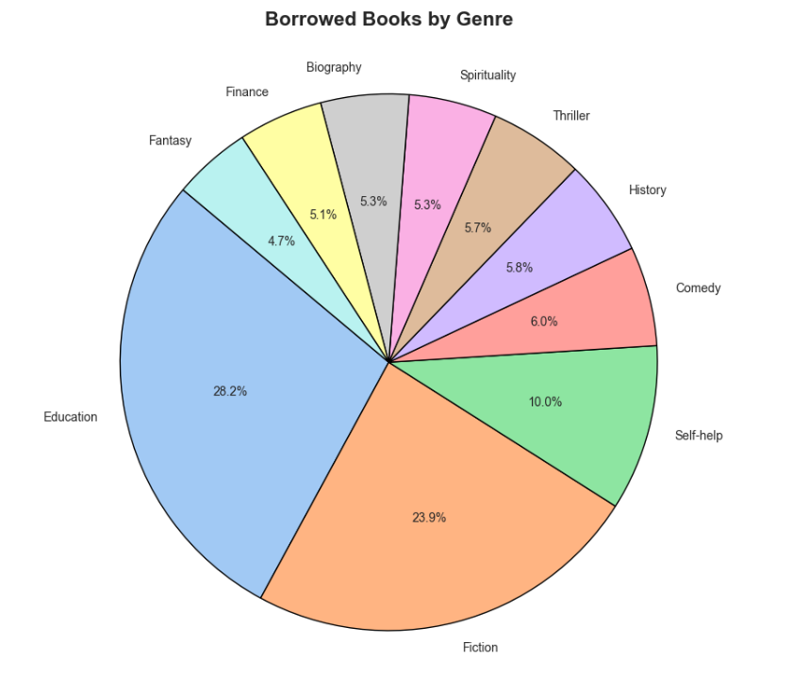

Pie: Borrowed books by genre
KPIs: Total borrowed, overdue count
Genre Distribution (Pie Chart)
Illustrates the popularity of different genres among borrowers.

Slide 8
Key Insights & Strategic Implications
The dashboard provides critical insights that can inform strategic decisions for library management, from collection development to policy adjustments.
Popularity Trends
Overdue Performance
Identify consistently popular titles and genres, guiding future book purchases and promotions.
Analyse overdue patterns.
Usage by Date/Status
Collection Health
Understand borrowing peaks and lulls, optimising staffing and resource availability.
Assess underutilised sections and potential areas for collection diversification.
This project successfully delivered a powerful analytical tool and provided invaluable hands-on experience across multiple domains of data science .

Slide 9

Thank You
Thank you for your time and attention. We hope this presentation offered valuable insights into School Library Usage Dashboard.
Questions?

